Slide 1
NFPA 704 Hazard Identification System

Slide 2
The National Fire Protection Agency (NFPA), in section 704 of the National Fire Code, specifies a system for identifying the hazards associated with materials. it is of value to anyone, who needs to handle potentially hazardous material.

Slide 3

The NFPA Diamond
The hazard identification signal is a color-coded array of four numbers or letters arranged in a diamond shape.

Slide 4
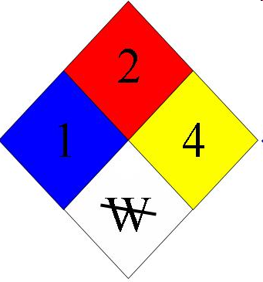
You will see hazard diamonds like this on trucks, storage tanks, bottles of chemicals, and in various other places around campus and around town.

Slide 5
The blue, red, and yellow fields (health, flammability, and reactivity) all use a numbering scale ranging from 0 to 4.
A value of zero means that the material poses essentially no hazard; a rating of four indicates extreme danger.

Slide 6
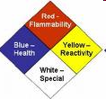
The NFPA Diamond

Slide 7
The NFPA Diamond
Red: Fire Hazard
0 – Will not burn
1 – Must be preheated for ignition; flashpoint above 200°F (93°C)
2 – Must be moderately heated for ignition, flashpoint above 100°F (38°C)
3 – Ignition may occur under most ambient conditions, flashpoint below 100°F (38°C)
4 – Extremely flammable and will readily disperse through air under standard conditions, flashpoint below 73°F (23°C)

Slide 8
The NFPA Diamond
Blue: Health Hazard
0 – Hazard no greater than ordinary material
1 – May cause irritation; minimal residual injury
2 – Intense or prolonged exposure may cause incapacitation; residual injury may occur if not treated
3 – Exposure could cause serious injury even if treated
4 – Exposure may cause death

Slide 9
The NFPA Diamond
Yellow: Reactivity Hazard
0 – Stable
1 – May become unstable at elevated temperatures and pressures, may be mildly water reactive
2 – Unstable; may undergo violent decomposition, but will not detonate. May form explosive mixtures with water
3 – Detonates with strong ignition source
4 – Readily detonates

Slide 10
The NFPA Diamond
White: Special Hazard
OX Strong Oxidizer
W water reactive

Slide 11
OTHER SIGNS

Slide 12


Slide 13


Slide 14


Slide 15


Slide 16


Slide 17
www.mysafetysign.com
http://www.mysafetysign.com/Safety-Signs

Slide 18


Slide 19
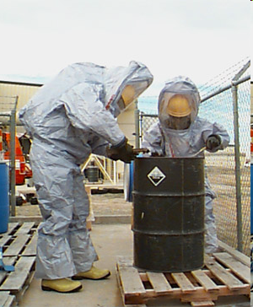
HANDLING HAZARDOUS
CHEMICAL

